Slide 1
Student Presentations Overview
Not more than 20 minutes
Should include:
Introduction
Event history
Your actions
Causal factors
Conclusion

Slide 2
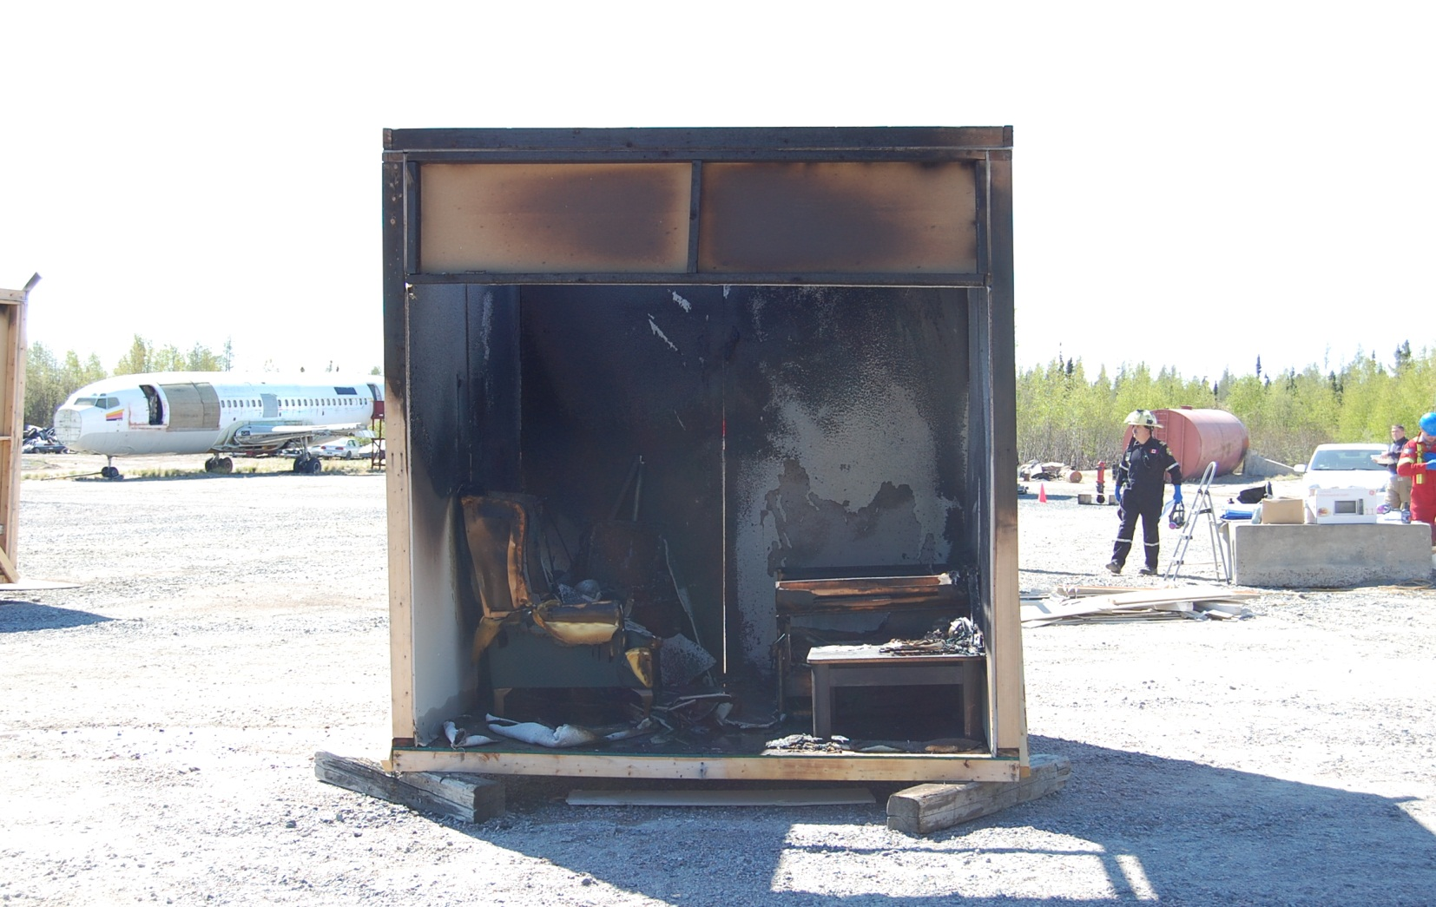
Structure Fire Address Date Report prepared by:

Slide 3
Your dispatch information
How and when you were notified
When you arrived at the scene
What you found on arrival

Slide 4
History of Event
A structure fire occurred at
The time the fire
Reported by _________at _____hours
Reporter stated
The owner is
Owner said that

Slide 5
Fire Department Information
IC _____ was in charge of the first crew at the scene.
They arrived on the scene at
They were met on scene by
Fire suppression info
Extent of damage

Slide 6
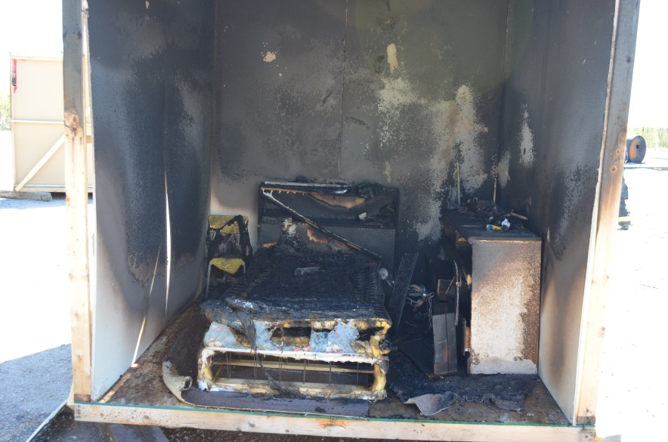
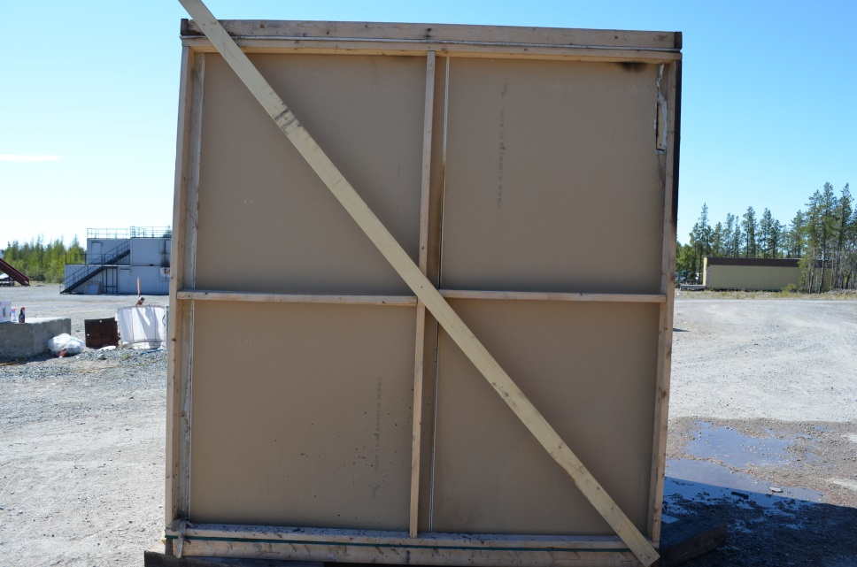
Scene Overview
Alpha Side
Bravo Side
Add any documentation or comments you want to make about the 360° – scene security – potential hazards

Slide 7
Investigation Process
Describe in detail the investigation process you followed

Slide 8
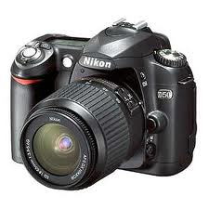
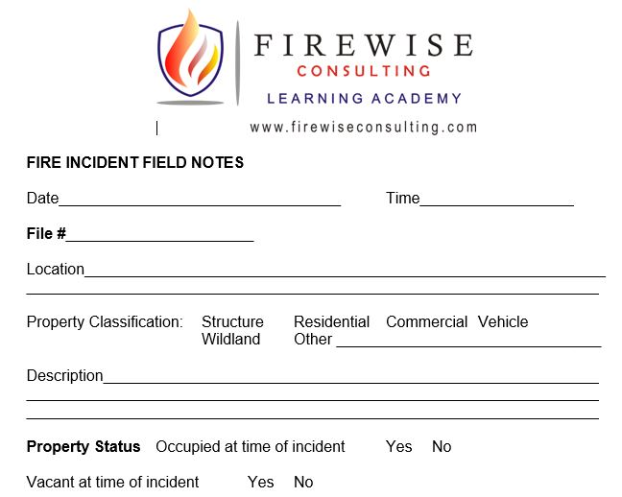
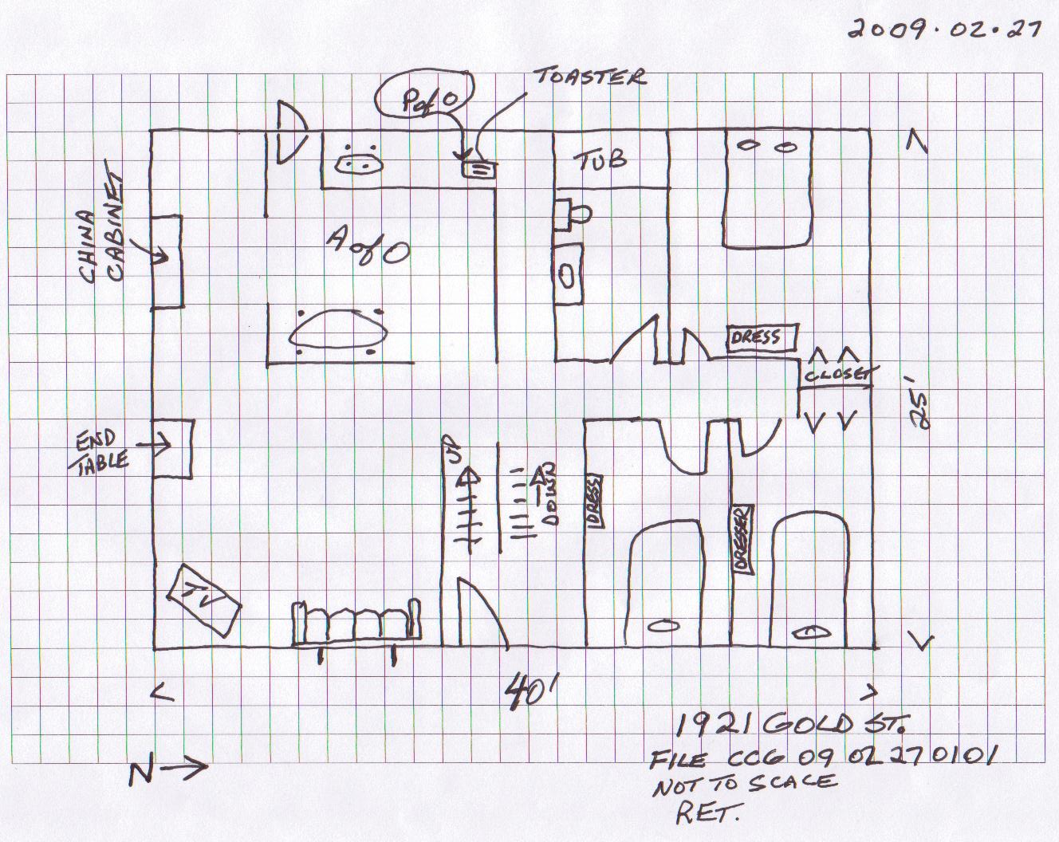
Scene Documentation
Notes:
Legend: P of O Point of Origin A of O Area of Origin

Slide 9
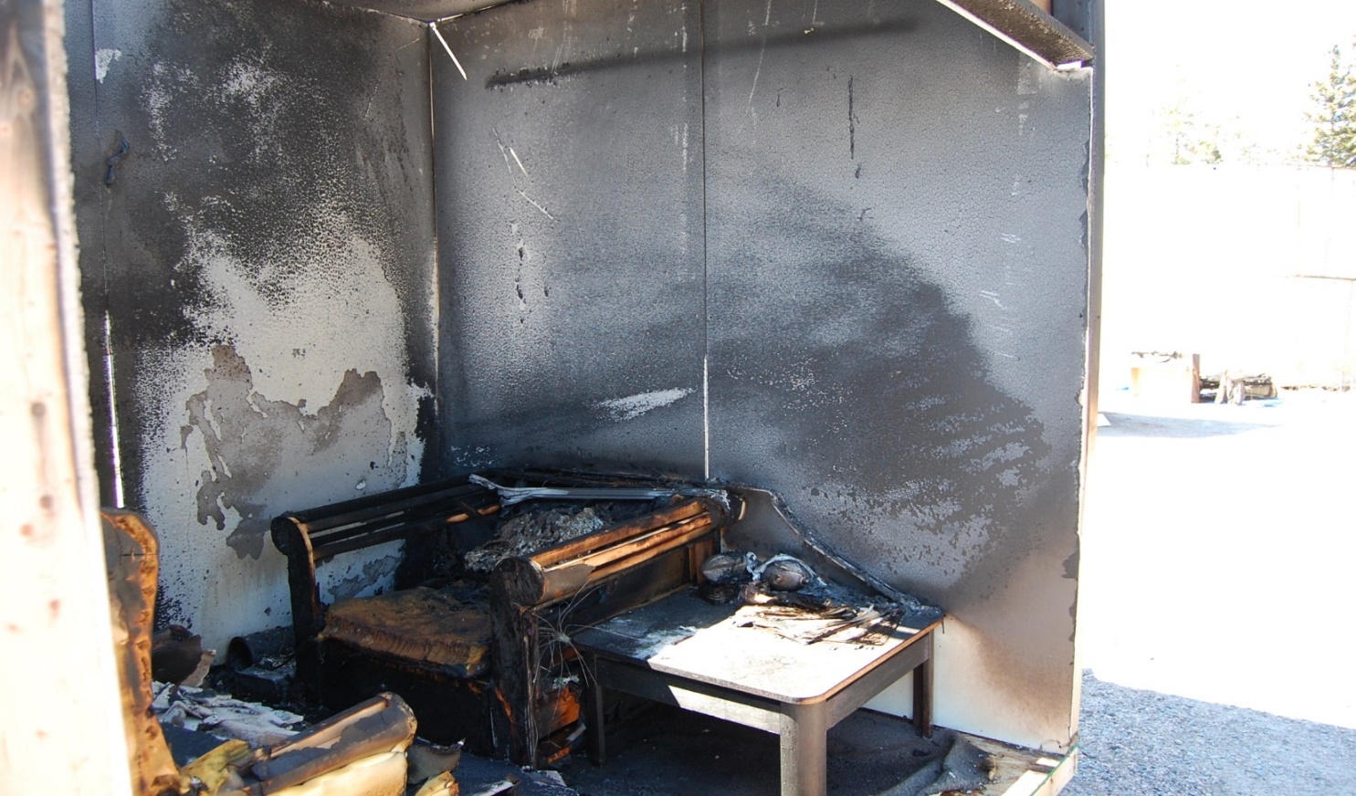
Area of Origin
The area of origin was in
Justify your comments

Slide 10
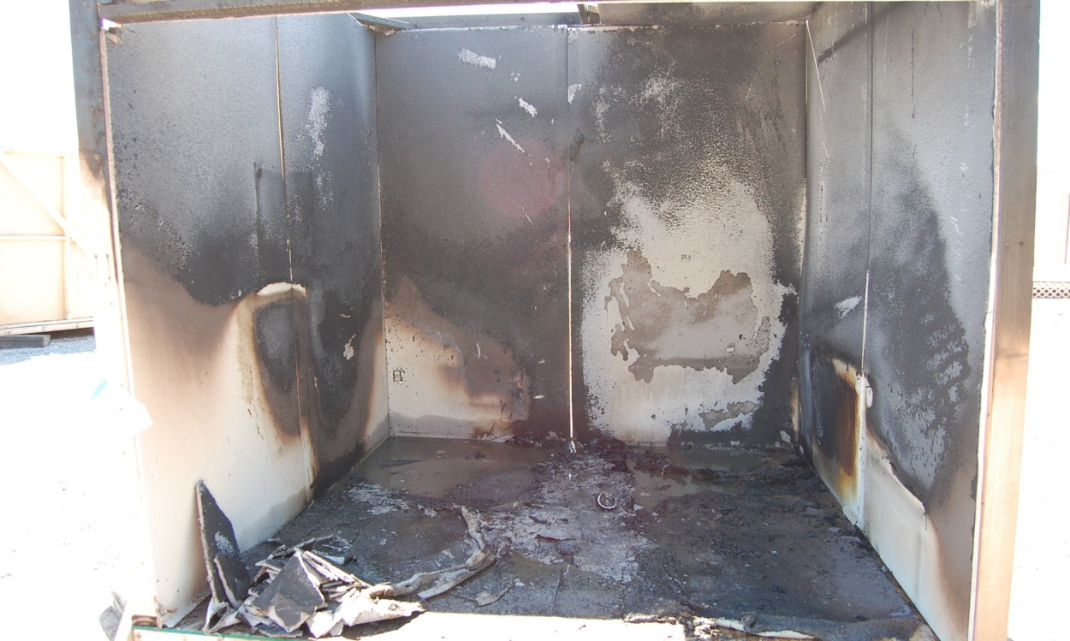
Area of Origin
The burn pattern on the wall was also an indication
A burn pattern
This photo shows
Red line indicates

Slide 11
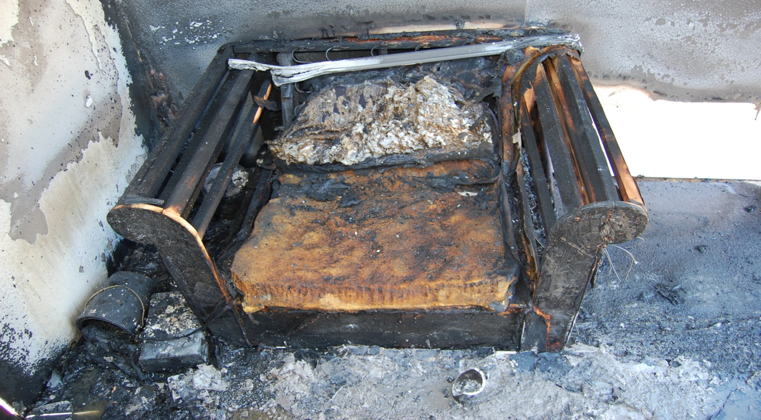
Point of Origin
The point of origin was
The heaviest damage was
The burn patterns

Slide 12
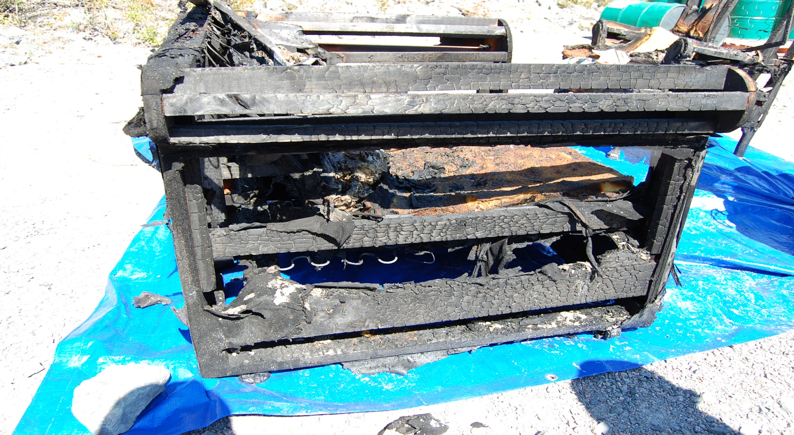
Point of Origin

Slide 13
Heat of Ignition
The source of heat was
Burn patterns
The owners stated.

Slide 14
Heat of Ignition
This photograph shows the remains of the ____ that
was at the point of origin

Slide 15
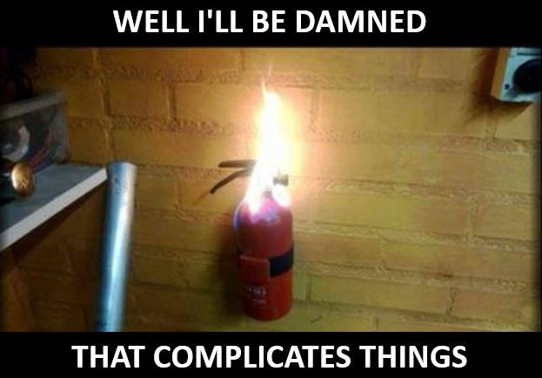
Material First Ignited
The material first ignited

Slide 16
Technical Assistance

Slide 17
Act or Omission
The cause of this fire was________
Supporting Facts
At the time of the fire there were
A ___________was located
There were no sources of electrical or mechanical
At the time of the occupants
There were no signs of forced entry
The candles near the point of origin

Slide 18
Opinions

Slide 19
Further Investigation Required
Add anything that was missing from the material that was provided for you to conduct a complete investigation such as:
incomplete interviews
further questions you need to ask

